Slide 1
Introduction to MongoDB
Module 7

Slide 2
Introduction to Mongo DB
Data storage and retrieval is an essential activity for almost every web applications. There exist several solutions to store the data and to retrieve it as per the demand of the application. Commonly known the three most solutions are :
Storage in files
Relational databases and NoSQL databases.
For our discussion purpose MongoDB is selected, which comes under the category of NoSQL database.

Slide 3
Understanding NoSQL?
NoSQL - Not Only SQL, bundled with technologies that are useful in data storage and data retrieval, with the loosely constrained models of well known SQL relational databases. NoSQL follows :
Simplified designs Horizontal scaling,
Finer control of the availability of data.
NoSQL technologies can be categorized into :
HBases - Column structure Rediss - Key/value structure and Neo4j - Graph structure.

Slide 4
Understanding NoSQL?
MongoDB is a NoSQL database; a document model where data objects are stored as separate documents inside a collection.
Collection & Documents
MongoDB provides :
High performance, High availability Automatic scaling, Degree of flexibility Scalability
Which are essential for implementing backend storage, essentially for web applications and services. MongoDB is one of the well known and supported NoSQL databases

Slide 5
Understanding Documents
Documents.....
A set of key-value pairs in MongoDB is called as Document. Documents in MongoDB will have dynamic schema.
All the documents in the same collection need not to have same set of fields, they may not possess the same set of fields
MongoDB is considered as a schema-less database, hence a collection can hold different type of objects.
An object in a collection is known as Document, which is represented as JSON like (JavaScript Object Notation).
Also known as structure with a list of key-value pair. Data is stored and queried in the form of BSON, a binary representation of JSON.

Slide 6
Document Schema
Document Name:
{
field1: value1,
field2: value2,
field3: value3,
...
fieldN: valueN
}
{
id = 1,
campus: ”VIT Chennai”,
school: ”SCOPE”,
strength: 10000,
course: [ name: ”B.Tech”, years: 4 , name: ”MTech”, years: 2 ]
}

Slide 7
Understanding Collections
Documents.....
A set of documents stored together is known as Collection, which is an analogous to the tables of an RDBMS.
Since MongoDB is a Schema-free database, a collection is allowed to store documents of different structure.
MongoDB does not require such a set of strict definition structure for data.

Slide 8
Collection Schema
{id = 1,
campus: ”VIT Chennai”,
school: ”SCOPE”,
strength: 10000,
auditorium: 5, course: [name: ”B.Tech”, years: 4 , name: ”MTech”,
years: 2 ]
} {
id = 2,
campus: ”VIT Vellore”, school: ”SENSE”, strength: 10000,
restaurant: 3, course: [ name: ”B.Tech”, years: 4 , name: ”MTech”, years: 2 ]
} }

Slide 9
Installation & configuration commands.
1. Stall MongoDB on Windows / Other OS
2. MongoDB Configuration
3. MongoDB Create Database
4. Creating the Collection in MongoDB
5. MongoDB Insert Document
6. MongoDB Querying all the documents / criteria
7. MongoDB Updating Document / update / save methods
8. MongoDB Delete Document using remove all / criteria
9. MongoDB drop collection
10. MongoDB Drop Database

Slide 10
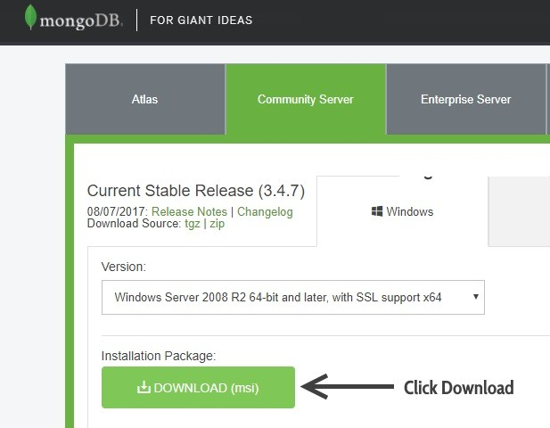
MongoDB download Page

Slide 11
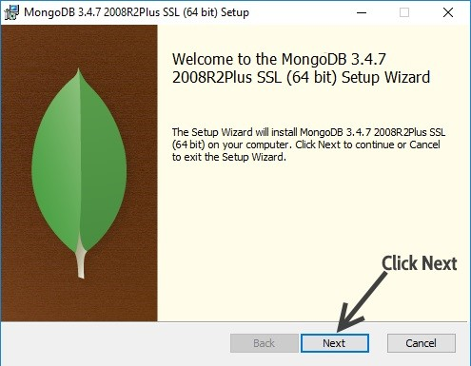
MongoDB installation

Slide 12
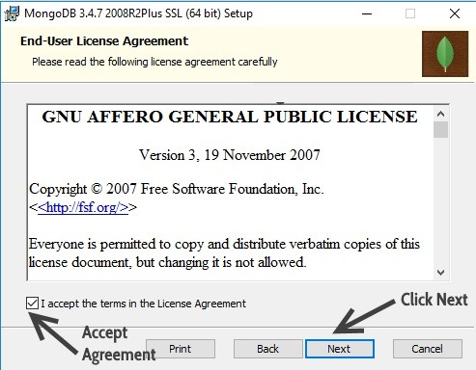
MongoDB user Agreement

Slide 13
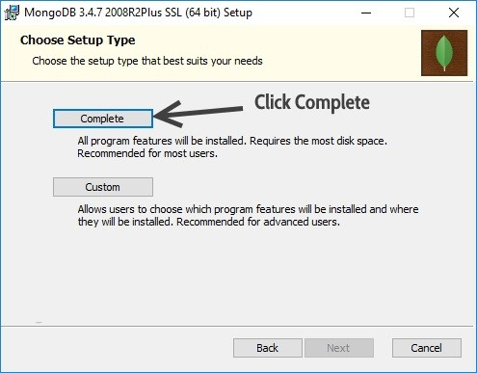
Setup type, choose Complete

Slide 14
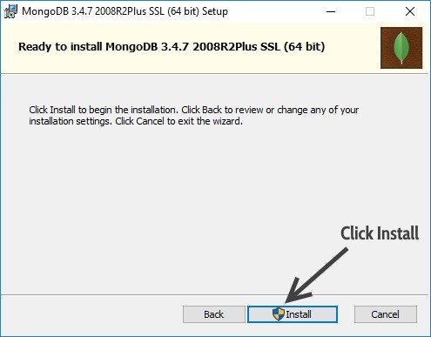
Click Install to begin the installation.

Slide 15
MongoDB Configuration
C :> Program Files > MongoDB
Create 2 Folders
Name first folder as data
Name other folder as log
Create another folder inside and name it as db:
Data stored here.

Slide 16
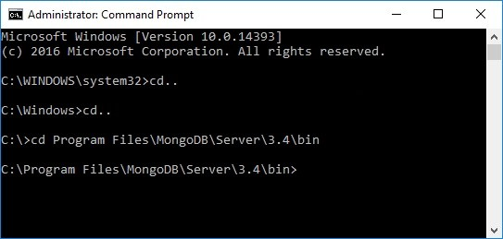
Navigate to the bin folder of MongoDB

Slide 17
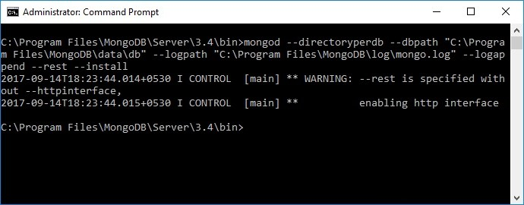
Configure the data & log folder and set MongoDB as service
mongod −− directoryperdb −− dbpath ”C:>Program Files>MongoDB>data>db” −−logpath ” C>Program Files>MongoDB>log>mongo.log” − −logappend −−rest
−−install

Slide 18
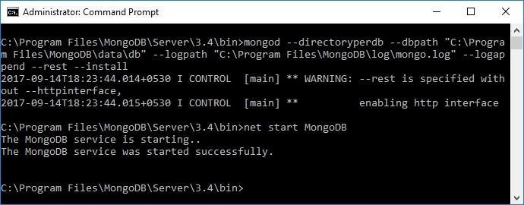
Start MongoDB as a service
net start MongoDB

Slide 19
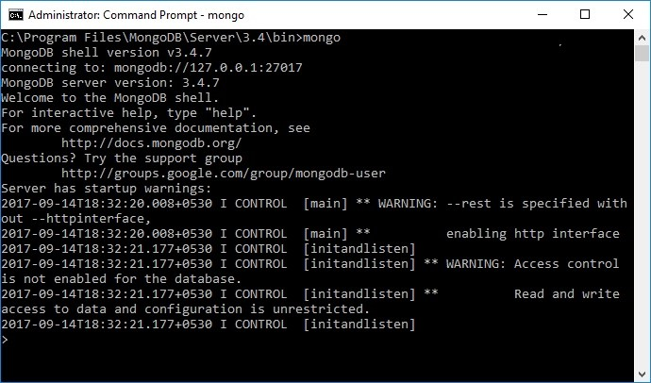
Start MongoDB as a service
mongo

Slide 20
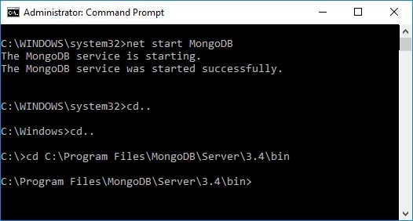
Start the MongoDB service
net start MongoDB
Following messages will display on prompt
The MongoDB service is starting..
The MongoDB service was started successfully.

Slide 21
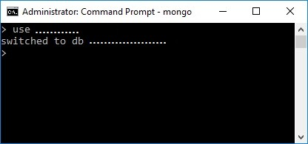
Create the database in MongoDB
mongo
use database name use

Slide 22
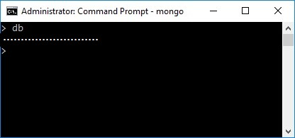
Currently connected database
db

Slide 23
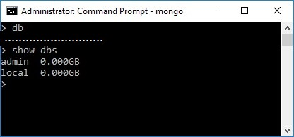
Lists down all the databases and their size on the disk
show dbs

Slide 24
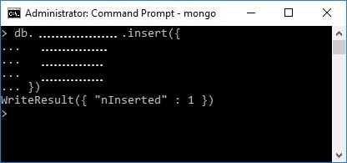
Creating the Collection in MongoDB on the fly
db.collection name.insert({key:value, key:value})

Slide 25
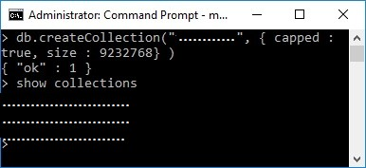
Creating collection with options before inserting the documents
db.createCollection(name, options) db.createCollection(”......., ...........”)

Slide 26
Creating collection with capped option
db.createCollection(”................”, capped : true, size : 9232768 )

Slide 27
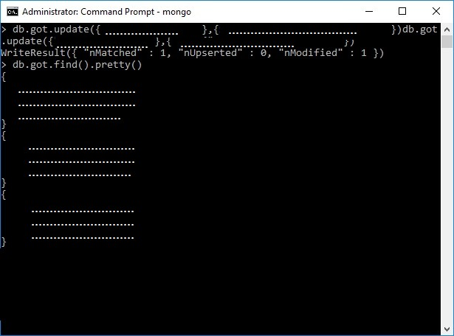
Update a document in a collection
db.collection name.update(criteria, update data) db.collection name.save( id:ObjectId(), new document )

Slide 28
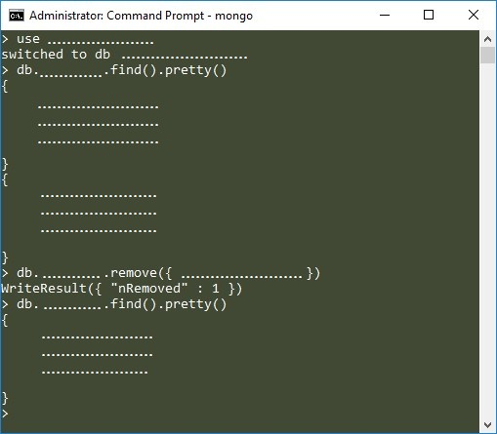
Drop collection
db.collection name.remove(delete criteria)
db.collection name.remove(delete criteria, justOne)

Slide 29
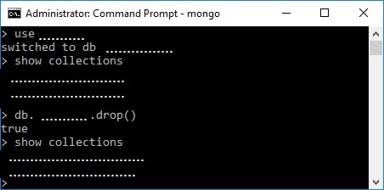
Drop collection
db.collection name.drop()

Slide 30
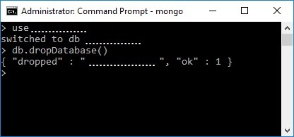
use database name db.dropDatabase()
Drop a Database

